Slide 1


PROJECT OPTIMIZATION AND REGRESSION
EXACT AND APPROXIMATE METHODS

Slide 2

The algorithm you provided is an approximation algorithm for the knapsack problem. The knapsack problem is a classic optimization problem in computer science and mathematics, where given a set of items with their respective weights and values, the goal is to determine the most valuable combination of items to fit within a given capacity constraint.
The provided algorithm uses a greedy approach to approximate the solution. It sorts the items in descending order of their value-to-weight ratio and then iteratively adds items to the knapsack until the capacity is reached. This greedy strategy selects the items with the highest value-to-weight ratio first, aiming to maximize the overall value of the items chosen.
However, it's important to note that this algorithm is not guaranteed to provide the optimal solution for all instances of the knapsack problem. It is an approximation algorithm that may provide a suboptimal solution in some cases.

Slide 3
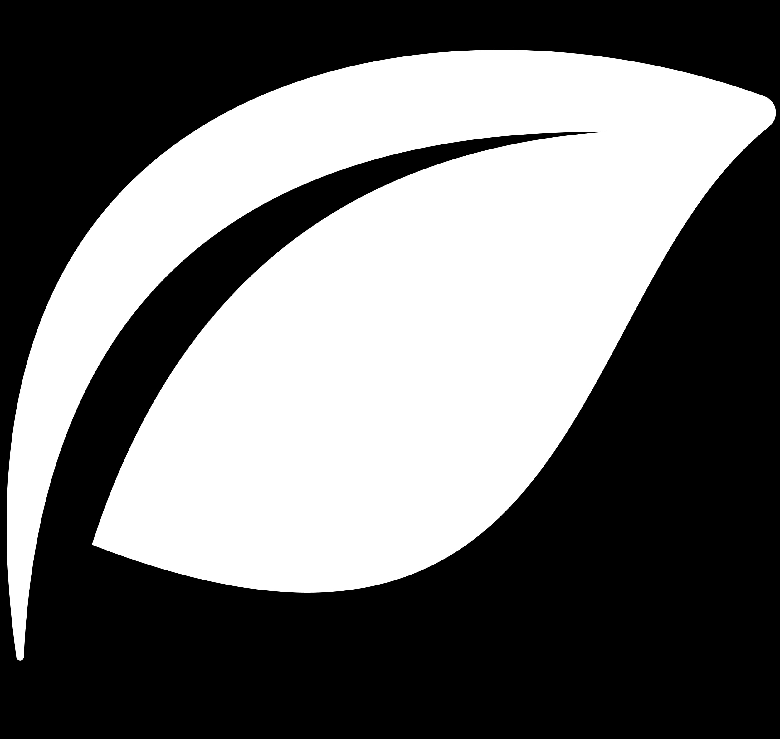
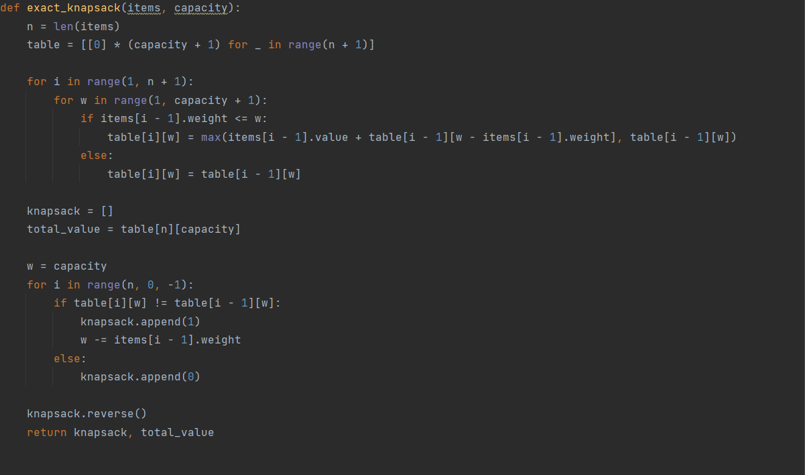
exact_knapsack

Slide 4
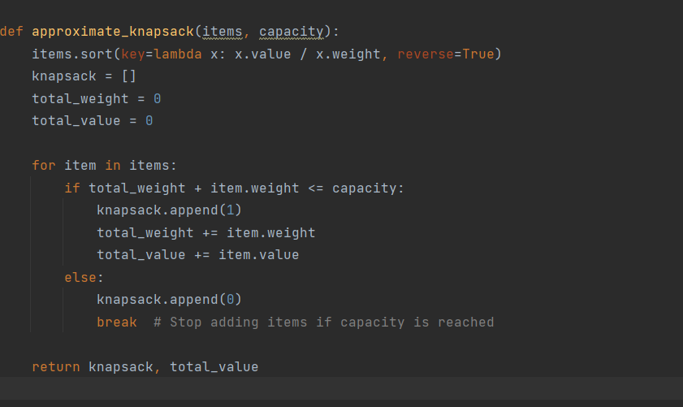
approximate_knapsack

Slide 5
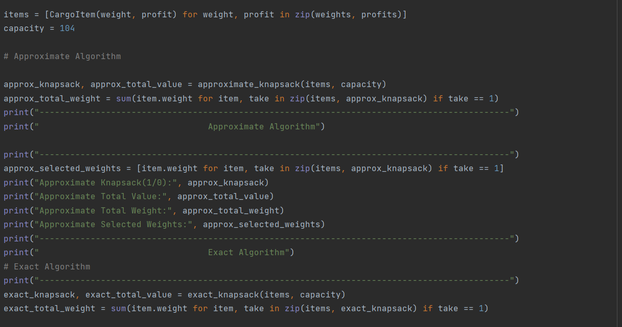

Slide 6
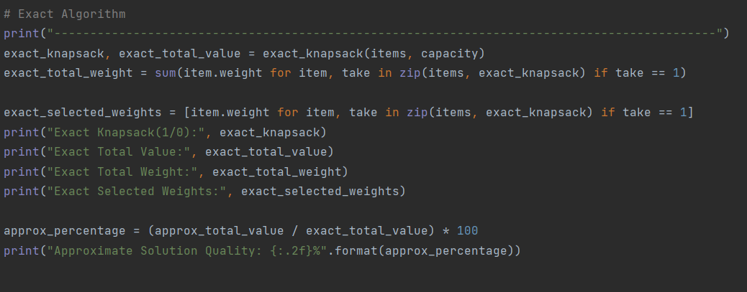
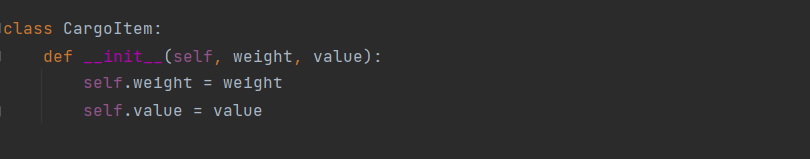

Slide 7
Experience of running the set given on the code

Slide 8
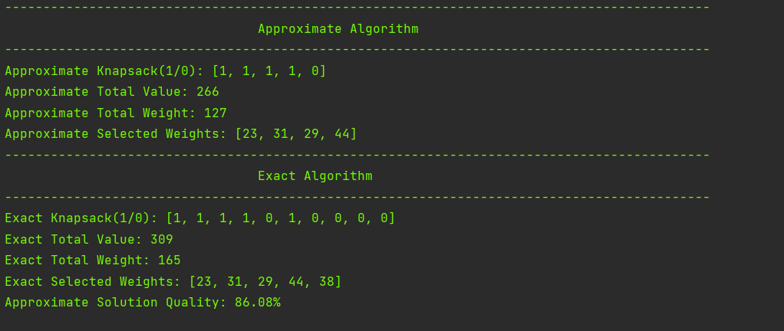
P01 is a set of 10 weights and profits for a knapsack of capacity 165.

Slide 9
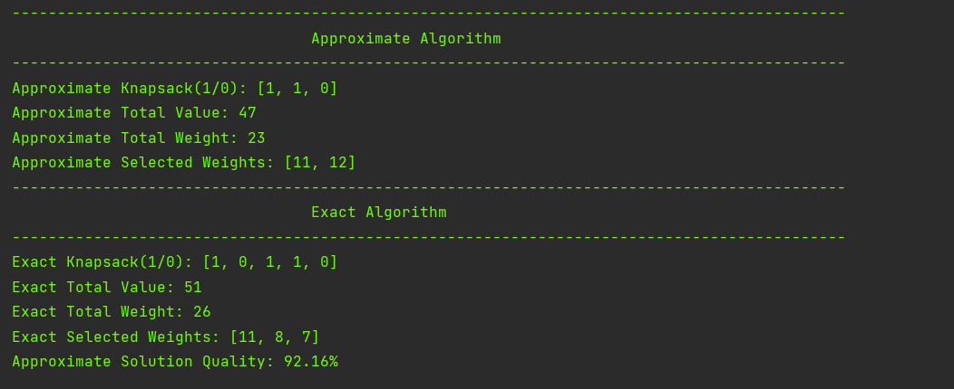
P02 is a set of 5 weights and profits for a knapsack of capacity 26.

Slide 10
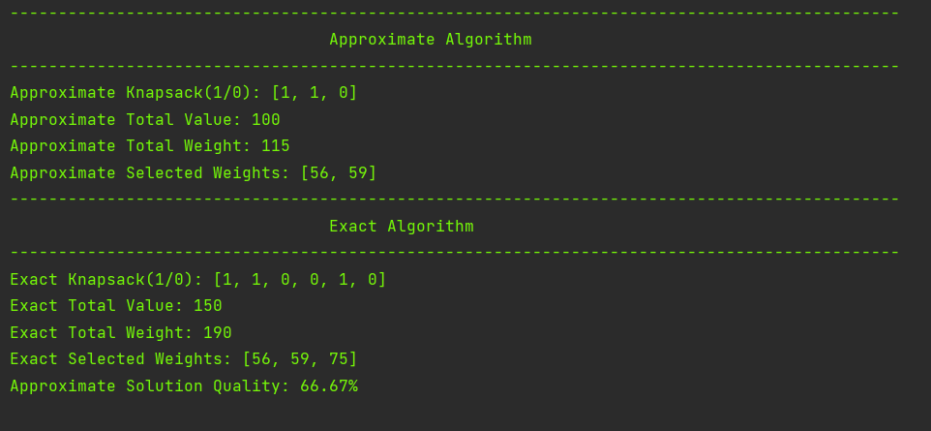
P03 is a set of 6 weights and profits for a knapsack of capacity 190.

Slide 11
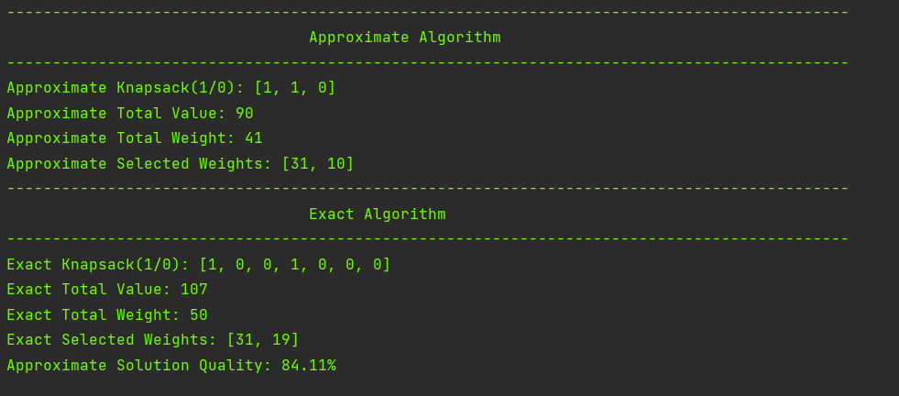
P04 is a set of 7 weights and profits for a knapsack of capacity 50.

Slide 12
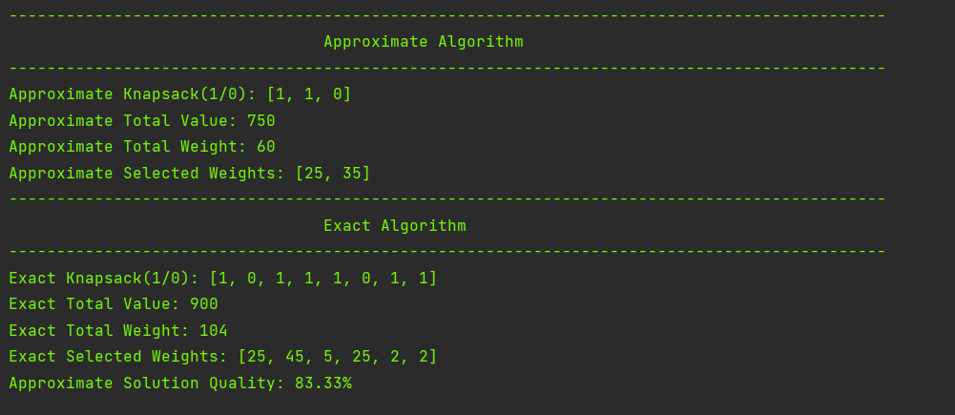
P05 is a set of 8 weights and profits for a knapsack of capacity 104.

Slide 13
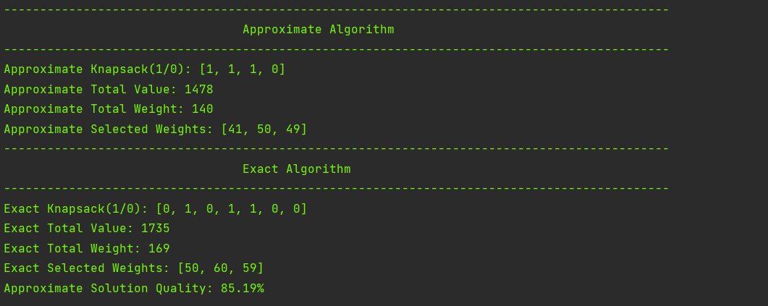
P06 is a set of 7 weights and profits for a knapsack of capacity 170. The knapsack can be packed to an optimal weight of 169.

Slide 14
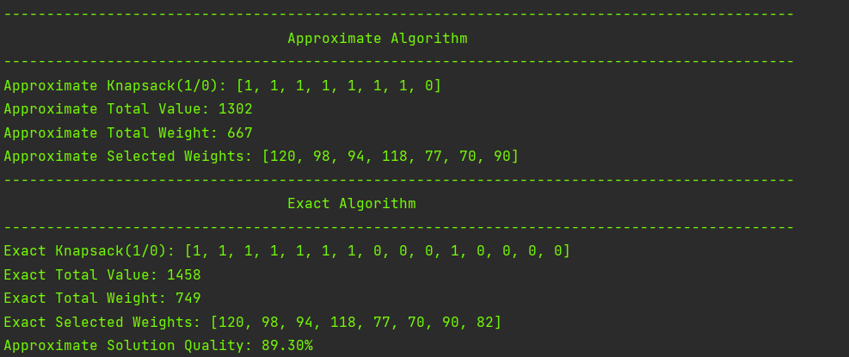
P07 is a set of 15 weights and profits for a knapsack of capacity 750, from Kreher and Stinson, with an optimal profit of 1458.

Slide 15
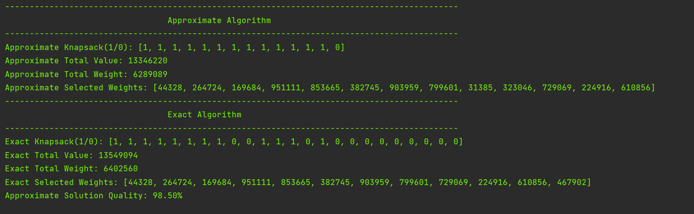
P08 is a set of 24 weights and profits for a knapsack of capacity 6404180, from Kreher and Stinson, with an optimal profit of 13549094.

Slide 16
THANK YOU

